Slide 1
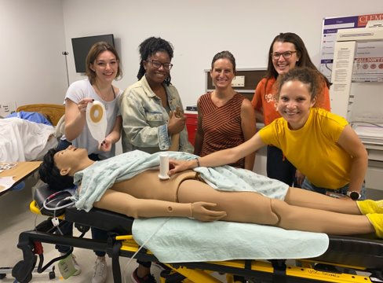
Applying Rhetorical Writing to FDA Documents for Reprocessed Medical Devices
510K Submissions
LaToya McDonald
Bioengineering PhD Candidate
WAC Fellow, SREB Fellow, ACE Fellow, NIH AIM-AHEAD Fellow

Slide 2
What is Rhetorical Writing?
Audience
Structured
Strategic
Purposeful
Clear
Concise
Validation (facts, statistics, case studies, etc)
Reading experience (transitions, word choice, etc)
Notes:
Using words and ideas in a persuasive language.

Slide 3
Characteristics of Rhetorical/Persuasive Writing
Persuasive Writing WHOs:
Who is your target audience?
Who is your secondary audience?
Who are you to your audience?
Persuasive Writing HOWs
How does the audience receive information?
How do you use words to communicate effectively?
Persuasive Writing KNOWs:
What DO YOU KNOW?
What does YOUR AUDIENCE KNOW
What does your AUDIENCE NEED TO KNOW?
What DON’T YOU KNOW?

Slide 4
Regulatory Agencies
Commodity Future Trading Commission (CFTC)
Consumer Product Safety Commission
Scientific Articles
Drug Enforcement Administration (DEA)
MS Thesis
Environmental Protection Agency (EPA)
PhD Thesis
Federal Energy Regulatory Commission (FERC)
Senior Projects
Food and Drug Administration
Literature Abstracts
United States Nuclear Regulatory Commission (NRC)
Conference Abstracts
Proposals
Conference Posters
Applications
Agencies or government departments that are responsible for the acts and regulations of a given sector of the US government. (Federal and State Levels)
Lab
Reports
Notes:
Why is this important? Every field of study has some sort of federal agency that make up the rules or regulations for that field. Federal Regulatory Agencies of the United States Government (einvestigator.com)

Slide 5
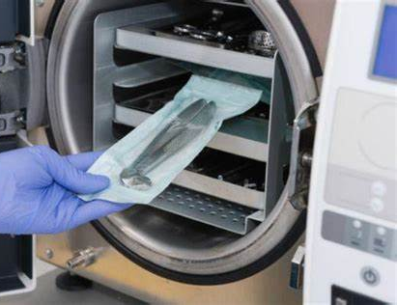
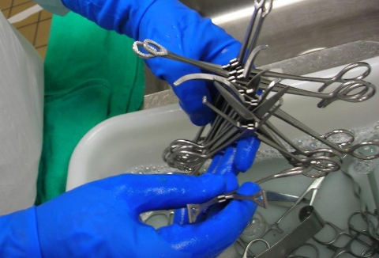
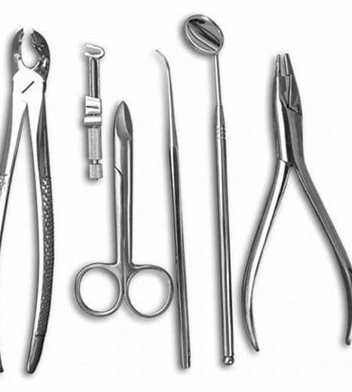
Why do we take regulations and proposals for reprocessed medical devices seriously? (Purpose)

Slide 6
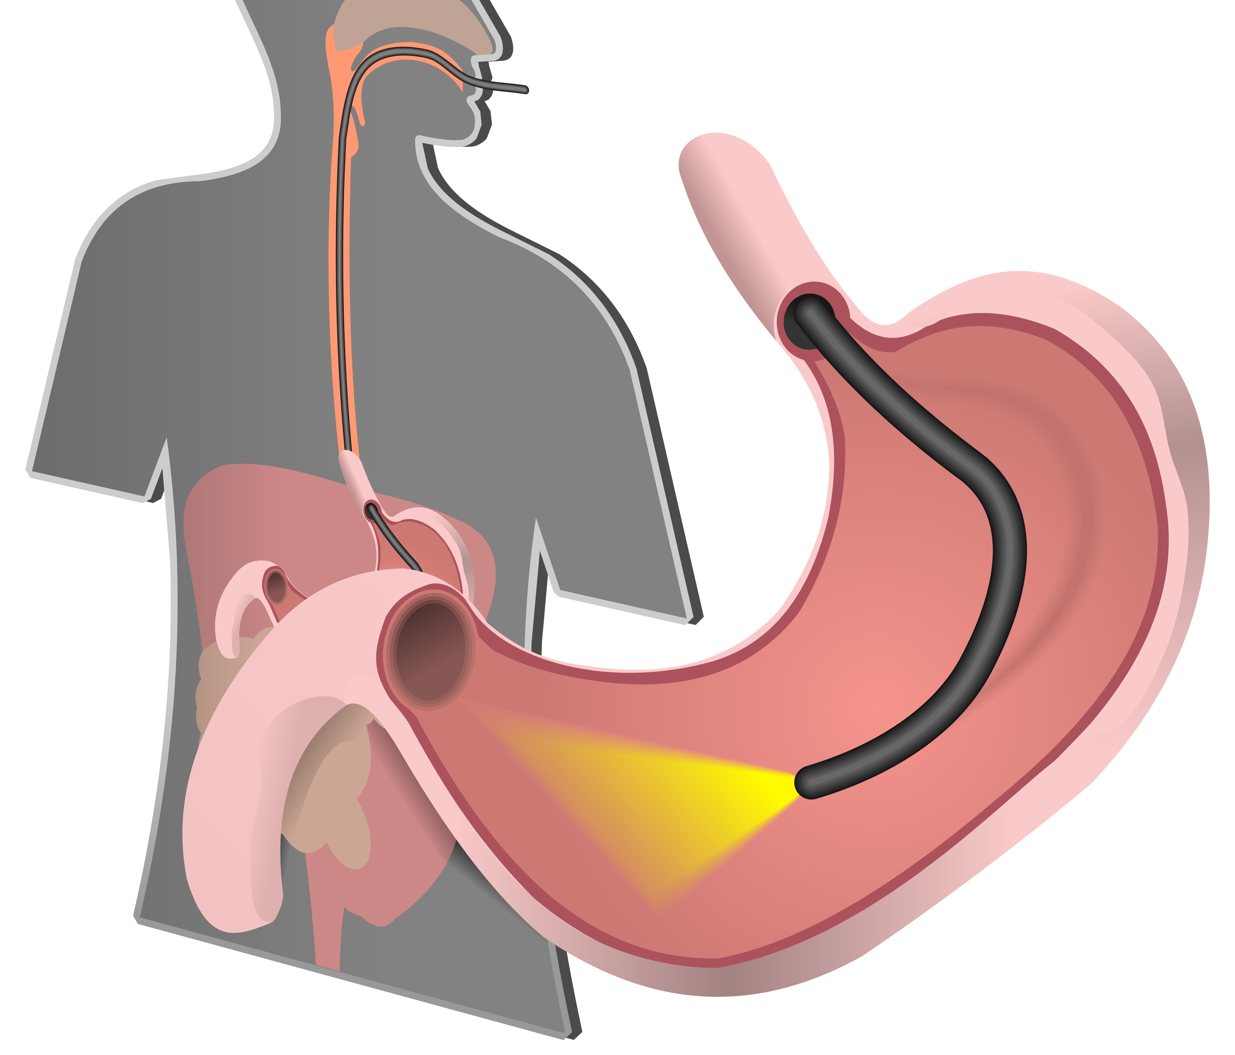
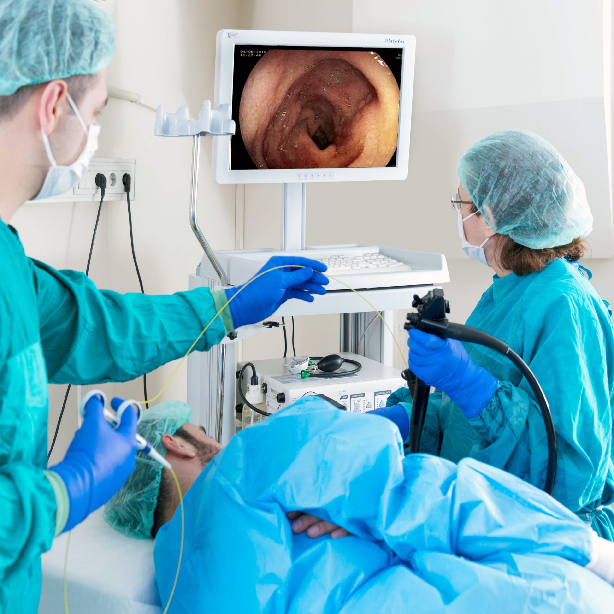
Scenario
Imaginary Hospital is known for having the best outcomes for upper GI endoscopies. Endoscopes are used to view the inside of a person’s GI.
Imaginary Hospital Administrator decides to investigate new endoscopes on the market to improve their procedures and increase the success rates even more for their team. They reach out to Medical Science Liaison to share information on their reusable endoscopy devices.
After review, Doctor Good Looking and his staff decide that they can develop a better device than what is on the market. They decide to submit a 510K proposal to the FDA based on their knowledge and experience from doing multiple upper GI endoscopies.

Slide 7
Persuasive Writing WHOs for Doctor Good Looking:
Who is your target audience?
Gastrointestinal-Urology FDA panel
Company/Hospital funding and supporting the project.
Who is your secondary audience?
Other healthcare workers
Who are you to your audience?
Proposer, Researcher, etc.

Slide 8
Persuasive Writing HOWs
510K Outline
Objective
Scope
Reference Docs
General Product Description
Regulatory Systems
Process Requirements
Device Specifications
Document Revision History
How does the audience receive information?
510K Submission
How do you use words to communicate knowledge to your audience effectively?
Informational
Persuasive

Slide 9
Persuasive Writing KNOWs:
What DO YOU KNOW?
Are there similar items already on the market?
Experiments
Experience
What does YOUR AUDIENCE KNOW
How the device works.
Protocols for safe re-use of device
What does your AUDIENCE NEED TO KNOW?
What is different about your device?
How do you meet the FDA requirements for the device (DATA, trials, etc.)
What DON’T YOU KNOW?
?????????
How do I get that needed information?
Persuade Us
510K

Slide 10
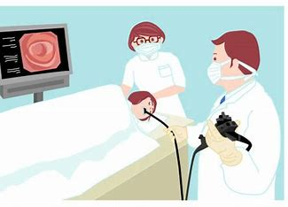
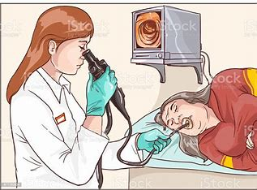
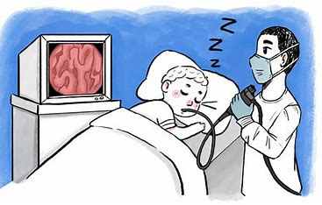
SUCCESS!!!!!!!
We The FDA Panel Agree
510K

Slide 11
Rhetorical Writing RECAP
Persuasive Writing WHOs:
Who is your target audience?
Who is your secondary audience?
Who are you to your audience?
Persuasive Writing HOWs
How does the audience receive information?
How do you use words to communicate effectively?
Persuasive Writing KNOWs:
What DO YOU KNOW?
What does YOUR AUDIENCE KNOW
What does your AUDIENCE NEED TO KNOW?
What DON’T YOU KNOW?

Slide 12
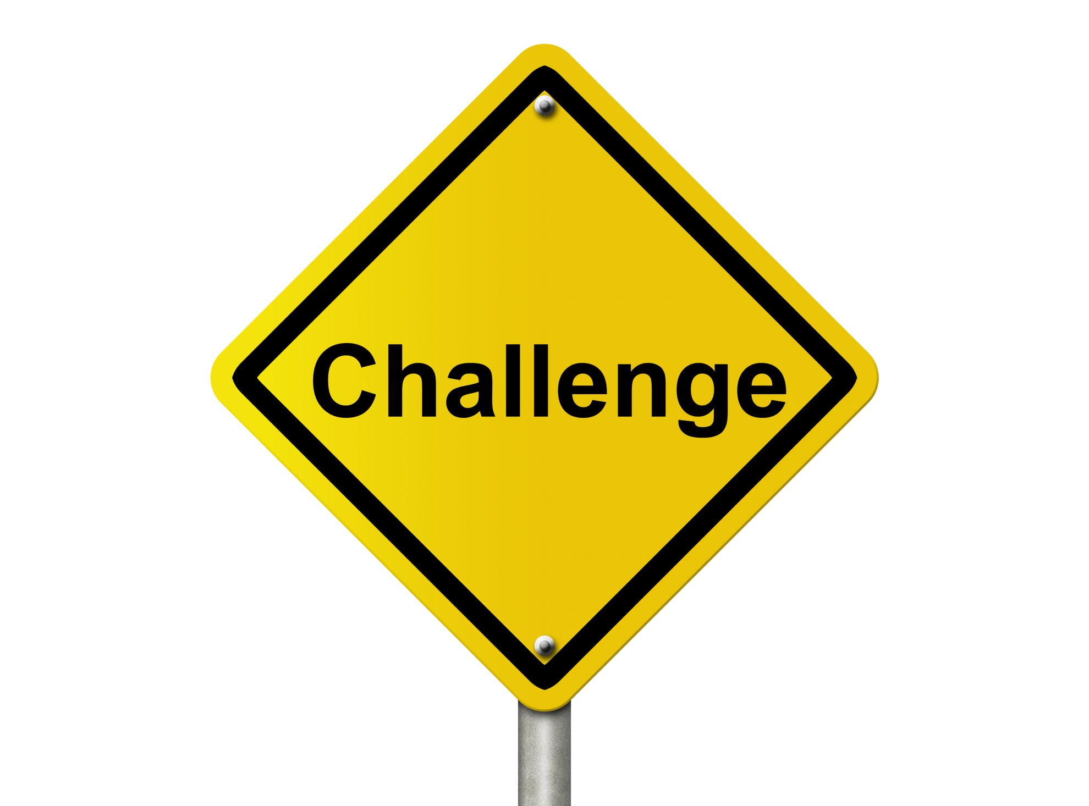
Applications
Challenge
Find the regulatory organizations in your field of study.
Determine the type of documents they receive
Determine how you can use rhetorical writing
Takeaway
Determine how you can apply rhetorical writing in your class assignments
Determine how you can apply rhetorical writing in your professional development. (Resumes, CVs, LinkedIn profile)

Slide 13
Thank you

