Slide 1
Synergy Wordpress
Workshop: Learning the Basics

Slide 2
Table of contents
Getting Started
Creating A New Post
Adding Images
Finishing Touches
Boosting the Backend
Click the sections to the right to quickly navigate to different parts of the presentation.

Slide 3
1.
GETTING STARTED
Log into Wordpress and learn about the Dashboard

Slide 4
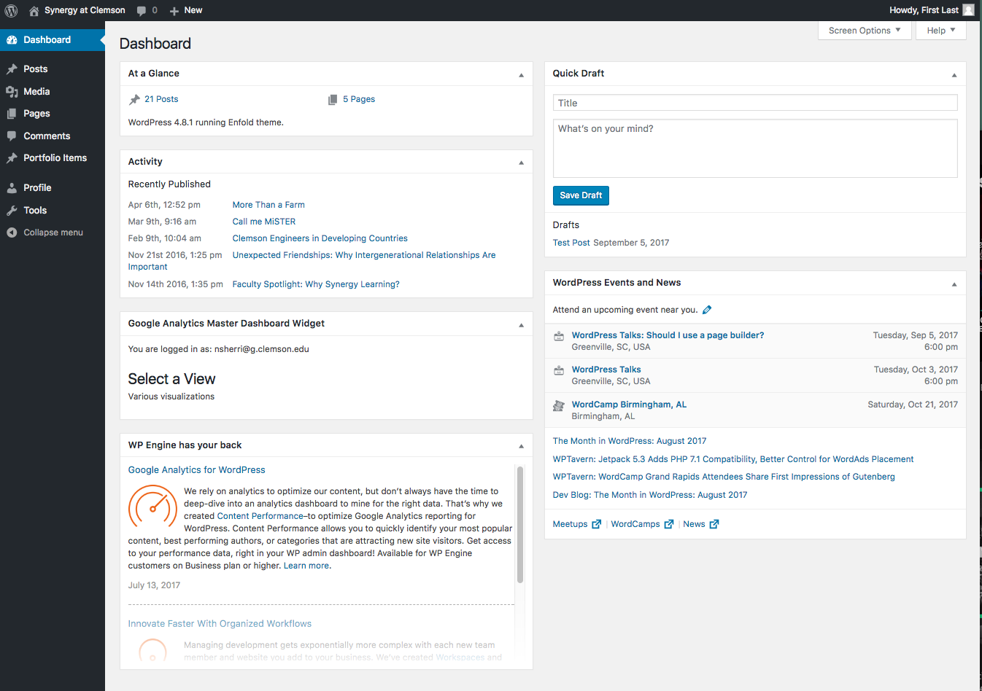
Getting Started
Log into your wordpress website with your username and password.
YOUR DASHBOARD

Slide 5
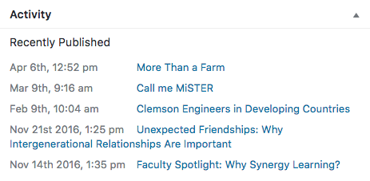
Getting Started
AT A GLANCE
ACTIVITY
Basic overview of the site
Quickly view the number of posts and pages currently on your site
Displays the most recently published posts newest-to-oldest
Easily access a recent article for a quick edit

Slide 6
2.
CREATING A NEW POST
Create and publish a new post on your Wordpress site

Slide 7
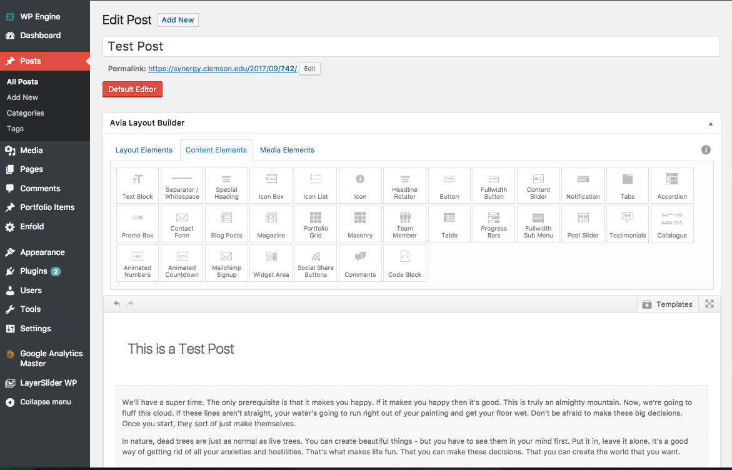
Create Your Post
GIVE IT A TITLE
The post’s title is how it will show up anywhere on your site and also determines its URL.

Slide 8
Advanced Layout
SELECT ADVANCED LAYOUT EDITOR
Layout Elements - Creates columns on the page to populate with content and media
Creates a hierarchy for the page
Have to set this up first in order to place content
Content Elements - Most post content is going to be here. Pretty much anything that isn’t an image, image gallery, or video
Media Elements - Anything related to images or videos. Any sort of visual aide for text. Capable of sliders, galleries, maps, etc.

Slide 9
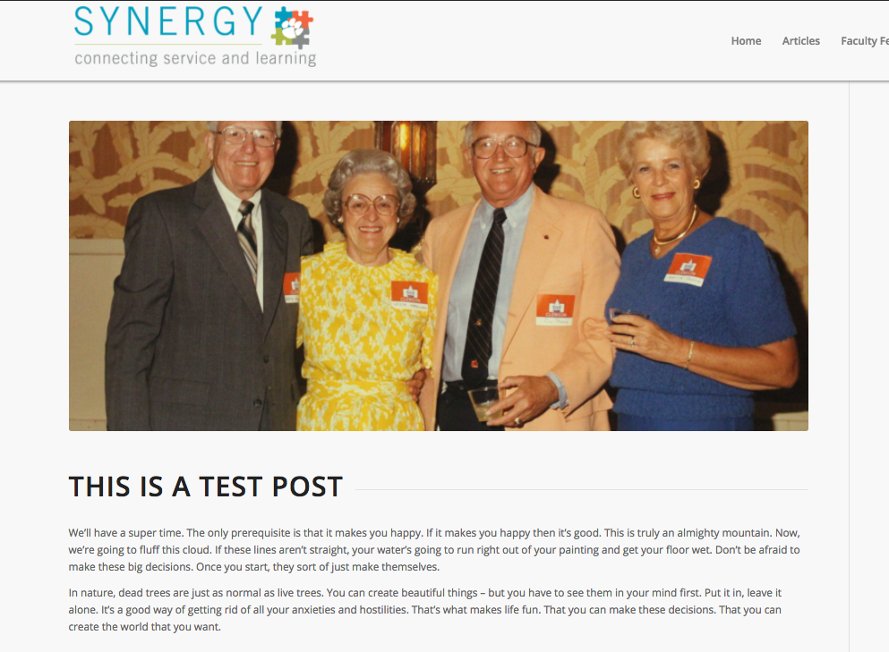
Populate Your Content
ADD A HEADING
Place your heading at the top of your post. This will most likely be the title of your article.
• Set to H1 size
TEXT BLOCK
Place a text block directly underneath your title. This is where the majority of your written content will go.
This element is highly customizable and can fit most of your content-related needs.
*TIP* If you want to get the structure of your post created before you fill it with your content, you can add dummy text from here.

Slide 10
3.
ADDING MEDIA
Use the Media Gallery to upload images and videos to your site

Slide 11
A picture is worth a thousand words
Images and videos are excellent visual tools for further developing the ideas you are presenting in your content.
They add interest and are more likely to keep readers.

Slide 12
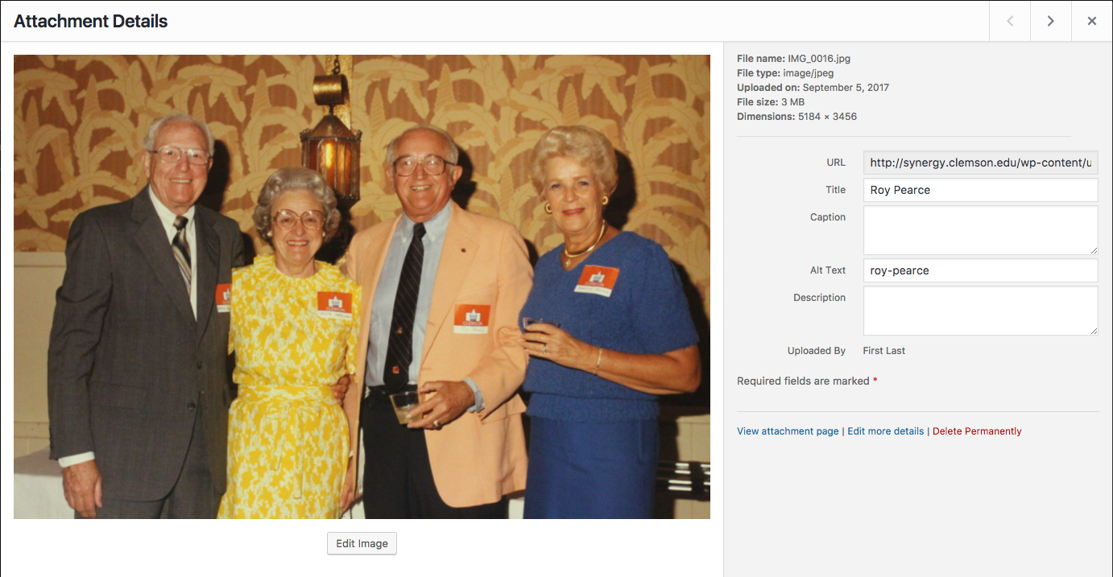
Adding Media
UPLOAD IMAGES AND VIDEOS TO THE MEDIA GALLERY
Select Library > Add New
SETTING UP AN IMAGE
*TIP* You can upload multiple files at once by dragging and dropping them.
Give it a proper title
Create alt-text, usually just the title all lowercase with hyphens
Add a description if you want

Slide 13
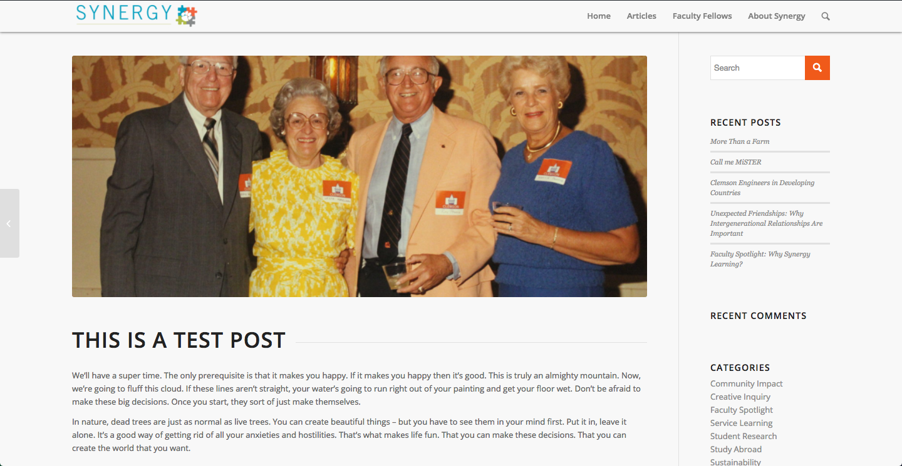
Your First Post is Almost Ready!

Slide 14
4.
FINISHING TOUCHES
Add content that allows readers to understand your post at a glance

Slide 15
Finishing Touches
OPEN UP SCREEN OPTIONS AT THE TOP
MAKE SURE THE FOLLOWING ARE CHECKED:
Excerpt
Discussion
Author
THESE SETTINGS WILL NOW BE BELOW THE CONTENT EDITOR
1. Excerpt
The excerpt will be displayed anywhere else on your site that a preview of your post shows up. This is useful for presenting a preview of what your post is about. Excerpts are generally very short.
Usually the first couple sentences from your post or a very brief summary are perfect.
2. Discussion
The discussion panel allows readers to leave comments on your post.
This is useful for generating a discussion and with Trackbacks allowed other websites can link your post on their site, thus potentially increasing viewership.
3. Author
Use this panel to input a different author if you are adding a post someone else wrote to your site.
4. Featured Image
The Featured Image panel is located on the bottom of the side panel. Set this image to the same image as your title image.
The featured image will show up along with the excerpt wherever a preview of your post appears.

Slide 16
5.
BOOST THE BACKEND
Categorize and add tags so your post can receive the most traffic

Slide 17
Categories & Tags
ADD YOUR POST TO THE APPROPRIATE CATEGORY
TAGS
Tags are the most important thing to add to your post in order for it to properly show up throughout your site and be picked up by search engines.
Proper tagging improves searchability and ensures search results bring up only the most relevant content.
Add any and all critical keywords that show up in your post as well any important names or places that show up.

Slide 18
Thank you very much for your time
If you want to learn more about Wordpress you can visit this site: https://learn.wordpress.com/
I’d also be happy to sit down and answer any questions you may have.

