Slide 1
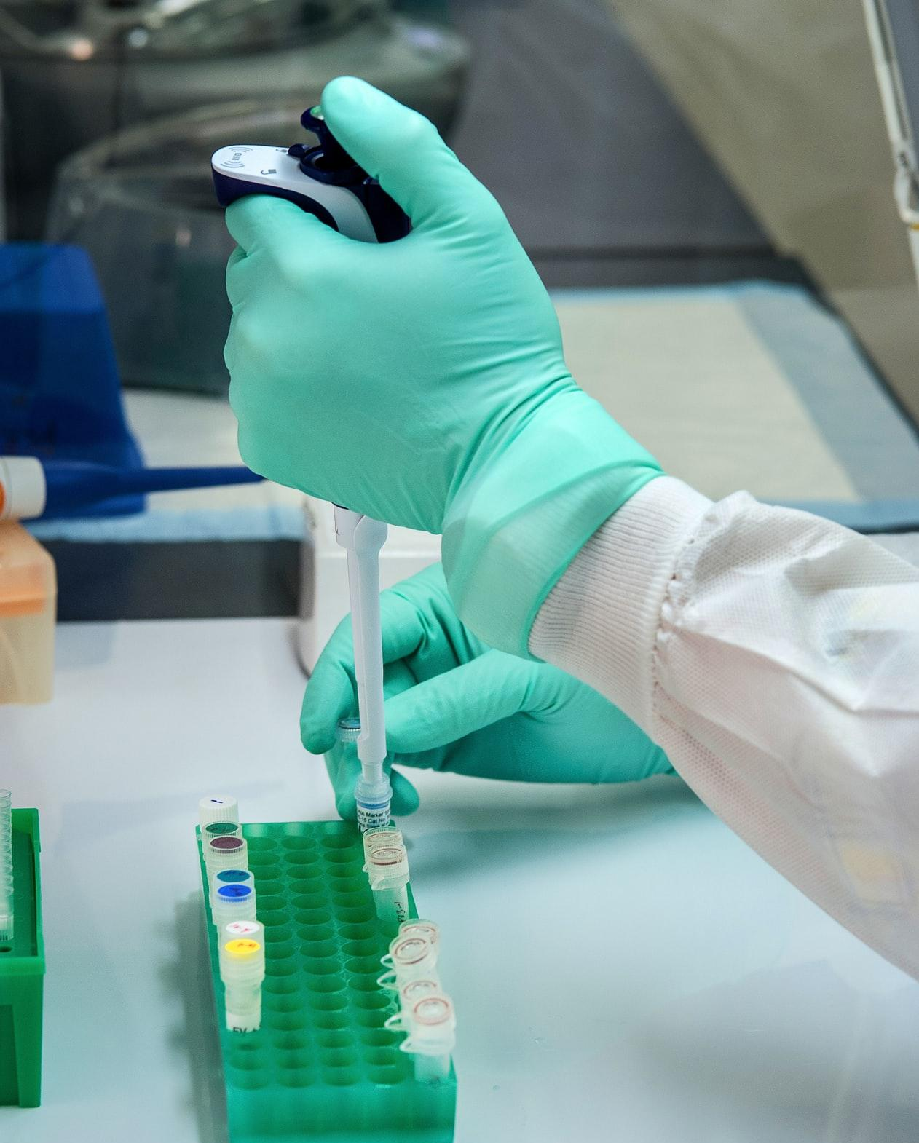
The Title Should Summarize The Project As A Whole With Emphasis On The Results
An author line should follow your title with names and the department
ABSTRACT:
METHODS:
CONCLUSION & DISCUSSION:
An abstract summarizes the entire research project. The abstract should not repeat what is stated in other sections, but should encapsulate critical features of all the other poster elements.
Answer the question: “What did the researchers do?”
Experimental methods are described in a concise paragraph or through an original representation that describes the flow and proper sequence of important aspects of the experimental protocol. This may be represented as a model, flowchart, or ordered bullet points.
Photographs and/or drawings may be used to illustrate relevant aspects of the experimental methods.
Major findings are clearly and concisely summarized with reference to the original purpose of the experiment. Conclusions are logical and consistent with the data presented. Where appropriate, authors may offer alternative interpretations of data and/or critically evaluate the effectiveness or limitations of their methods. Suggestions for future studies are noted that expand understanding of the question tested.
INTRODUCTION:
RESULTS:
The introduction clearly defines the research question as well as the rationale for the study. Relevant background information provides a context for the study and reports important trends, findings, and natural history information gleaned from other sources (primary literature, web, texts, etc.).
Researce
Results
Results
REFERENCES:
Results
Results
Results
Results
References are cited with a complete bibliography that is correctly formatted according to CSE guidelines.
Photo by CDC on Unsplash
Data is organized in clearly labeled tables, graphs, and figures that are appropriate to the type of data. Descriptive captions accompany all figures. Titles, legends, keys, and other descriptors contribute to organization and clarity of the data. If relevant, results may also include drawings and/or photographs that aid in data interpretation.

